Slide 1
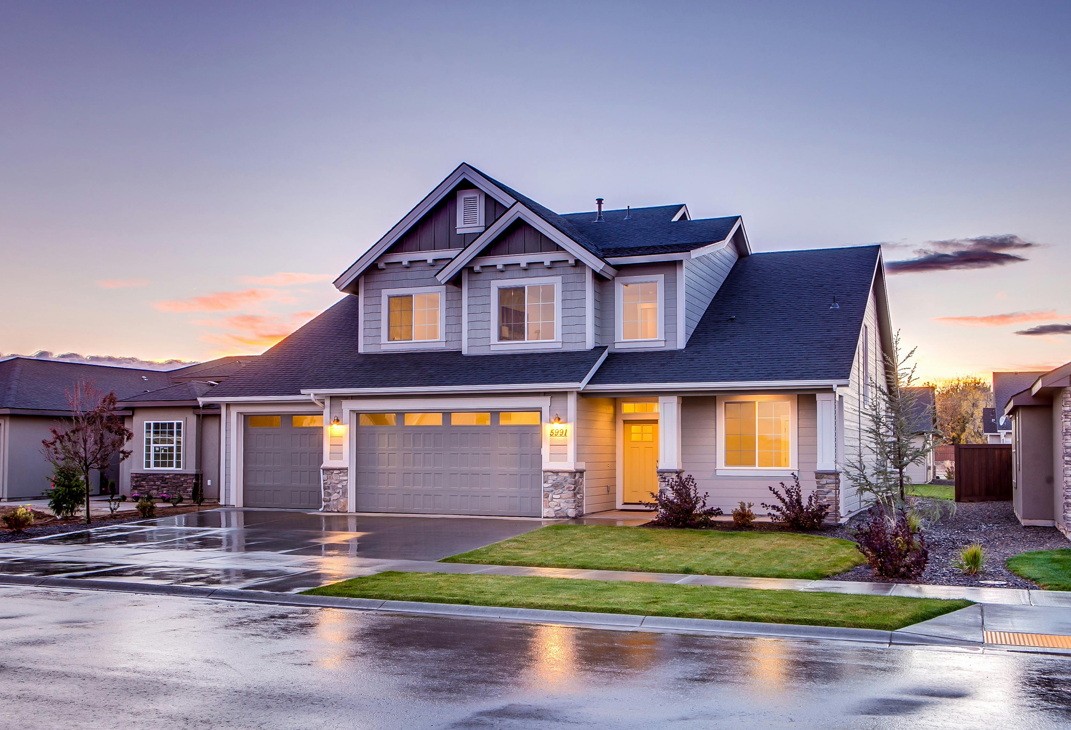

AMS GROUP
Home
About
Content
Others
LIVING+
A RENTAL SYSTEM
Members:
M. Sibtain 22i-0887
Abdullah Shakir 22i-1138
Maaz Khan 22i-2125

Slide 2

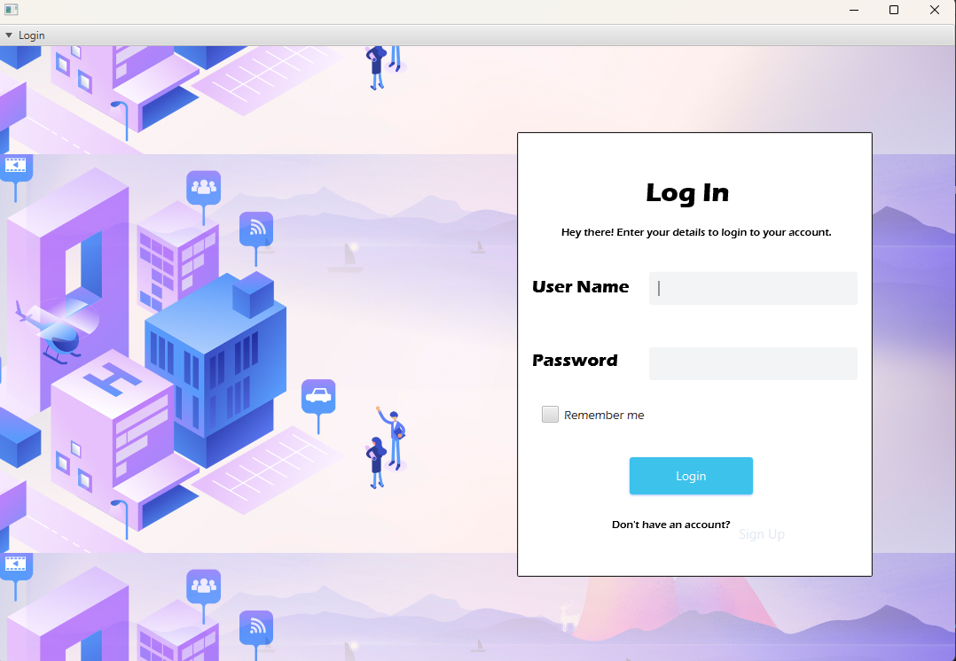
AMS Group
Home
About
Content
Others
PURPOSE
To provide a streamlined platform for hostel and
rental management, catering to users searching for accommodations and property
owners managing properties.
Target Audience:
Renters and property owners.

Slide 3
AMS GROUP
Home
About
Problem
Others
PROBLEM
STATEMENT
personalization
efficiency
dissatisfaction
Traditional accommodation systems lack personalization
Relies on manual processes or outdated methods that lead to errors
Lack of transparency, and limited control

Slide 4


AMS GROUP
Home
About
Content
Others
OBJECTIVES
Simplify property discovery and booking processes.
Select food options based on dietary preferences and availability.
Efficient management interface for handling accommodations & tenant needs.
Ensure secure payment processing and transparent transaction tracking for food orders and property bookings.

Slide 5
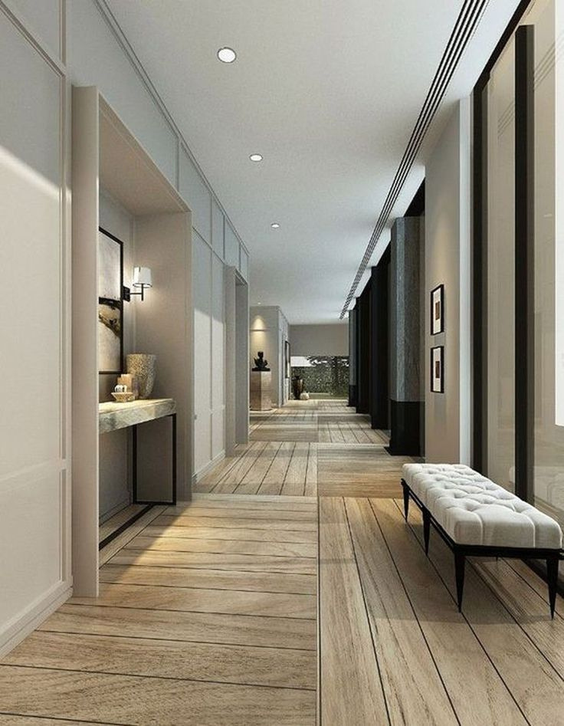
Home
About
Content
Others
Property Browsing and Filtering
Menu Selection and Ordering
Payment Handling
Eviction Management
Feedback and Reviews
BUSINESS LOGIC
OVERVIEW

Slide 6
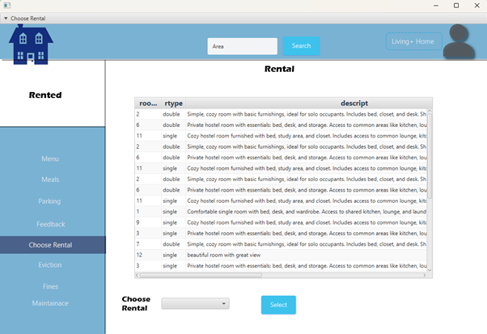
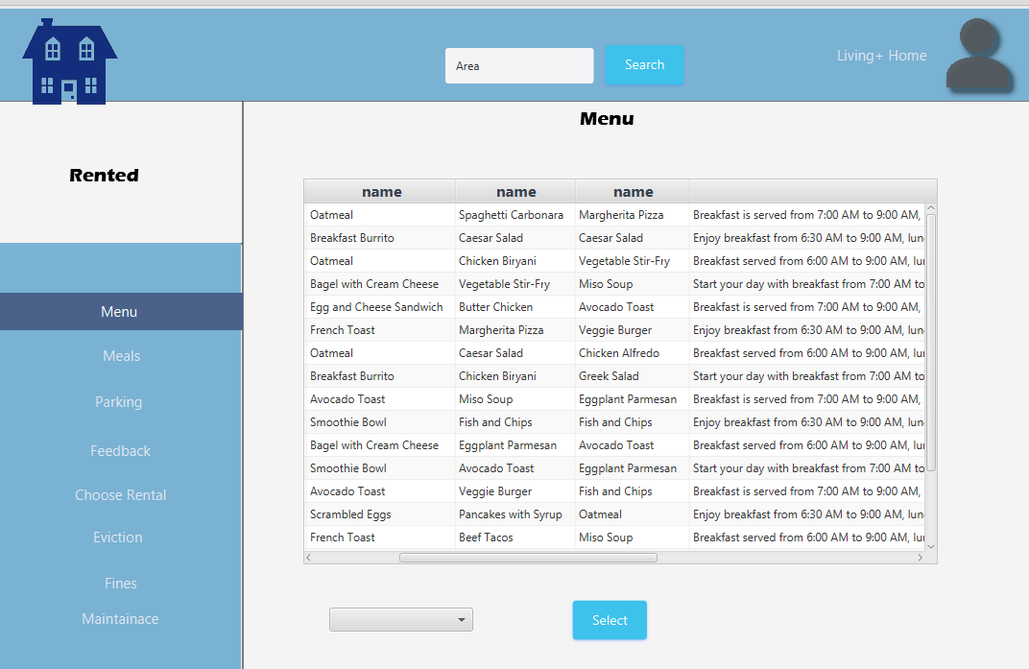
AMS GROUP
Home
About
Content
Others
KEY FEATURES
Tenants
Property search with filters.
Booking and payment tracking.
Customized Meal Plans

Slide 7
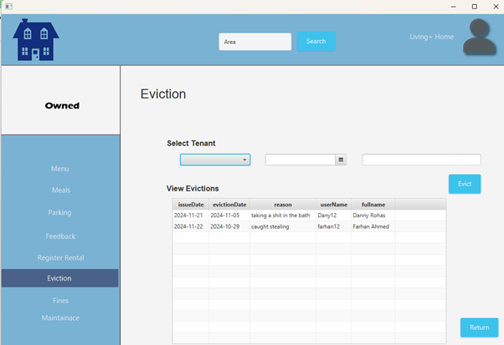
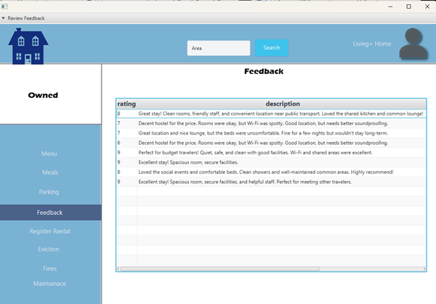
AMS GROUP
Home
About
Content
Others
KEY FEATURES
Owner
Property management dashboard.
Booking and payment tracking.
Tenant communication and maintenance request handling.

Slide 8

Wardiere, Inc,
Home
About
Content
Others
Implementation
DETAILS
Libraries: JavaFX SDK, MySQL Connector/J.
Tables for users, properties, bookings, payments.
Localhost setup with MySQL.
Allows property owners to notify tenants of evictions through the system.

Slide 9
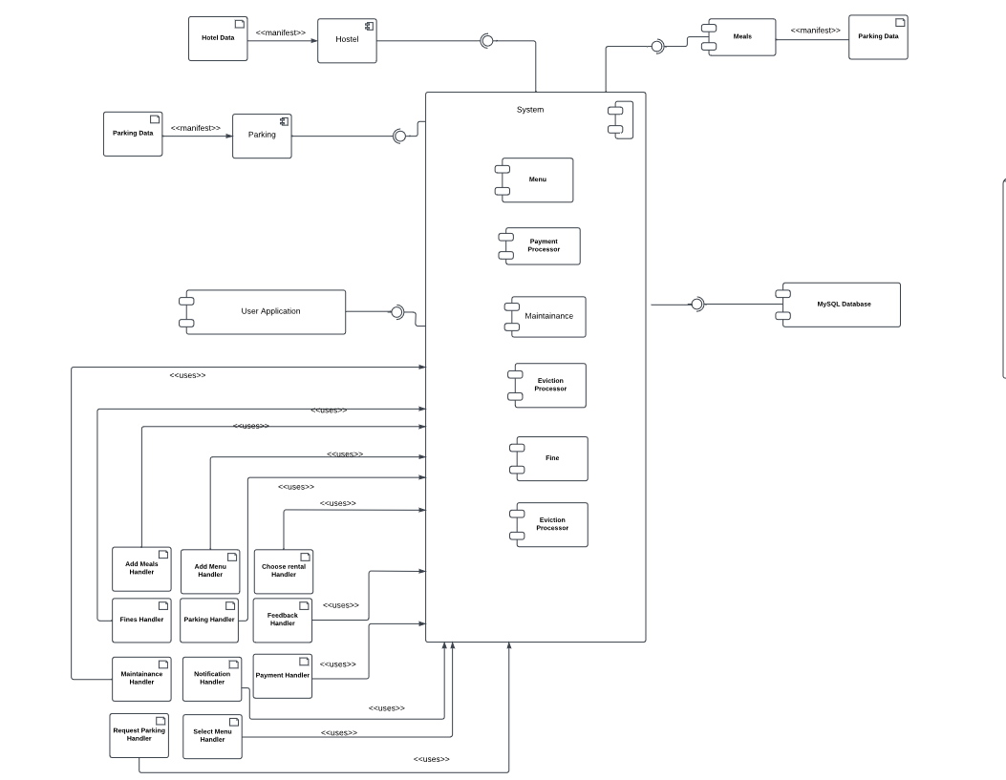
Wardiere, Inc,
Home
About
Content
Others
SYSTEM
COMPONENTS
User Interface (UI Component)
Controller Layer
Data Access Object (DAO) Layer
Utility Component
Database Component

Slide 10

AMS GROUP
Home
About
Content
Others
Challenges &
SOLUTIONS
Establishing reliable connection between the JavaFX application and the MySQL database.
Ensuring seamless user experience with minimal response times for search and booking operations.
Implementing auto notification for tenant notifications.

Slide 11
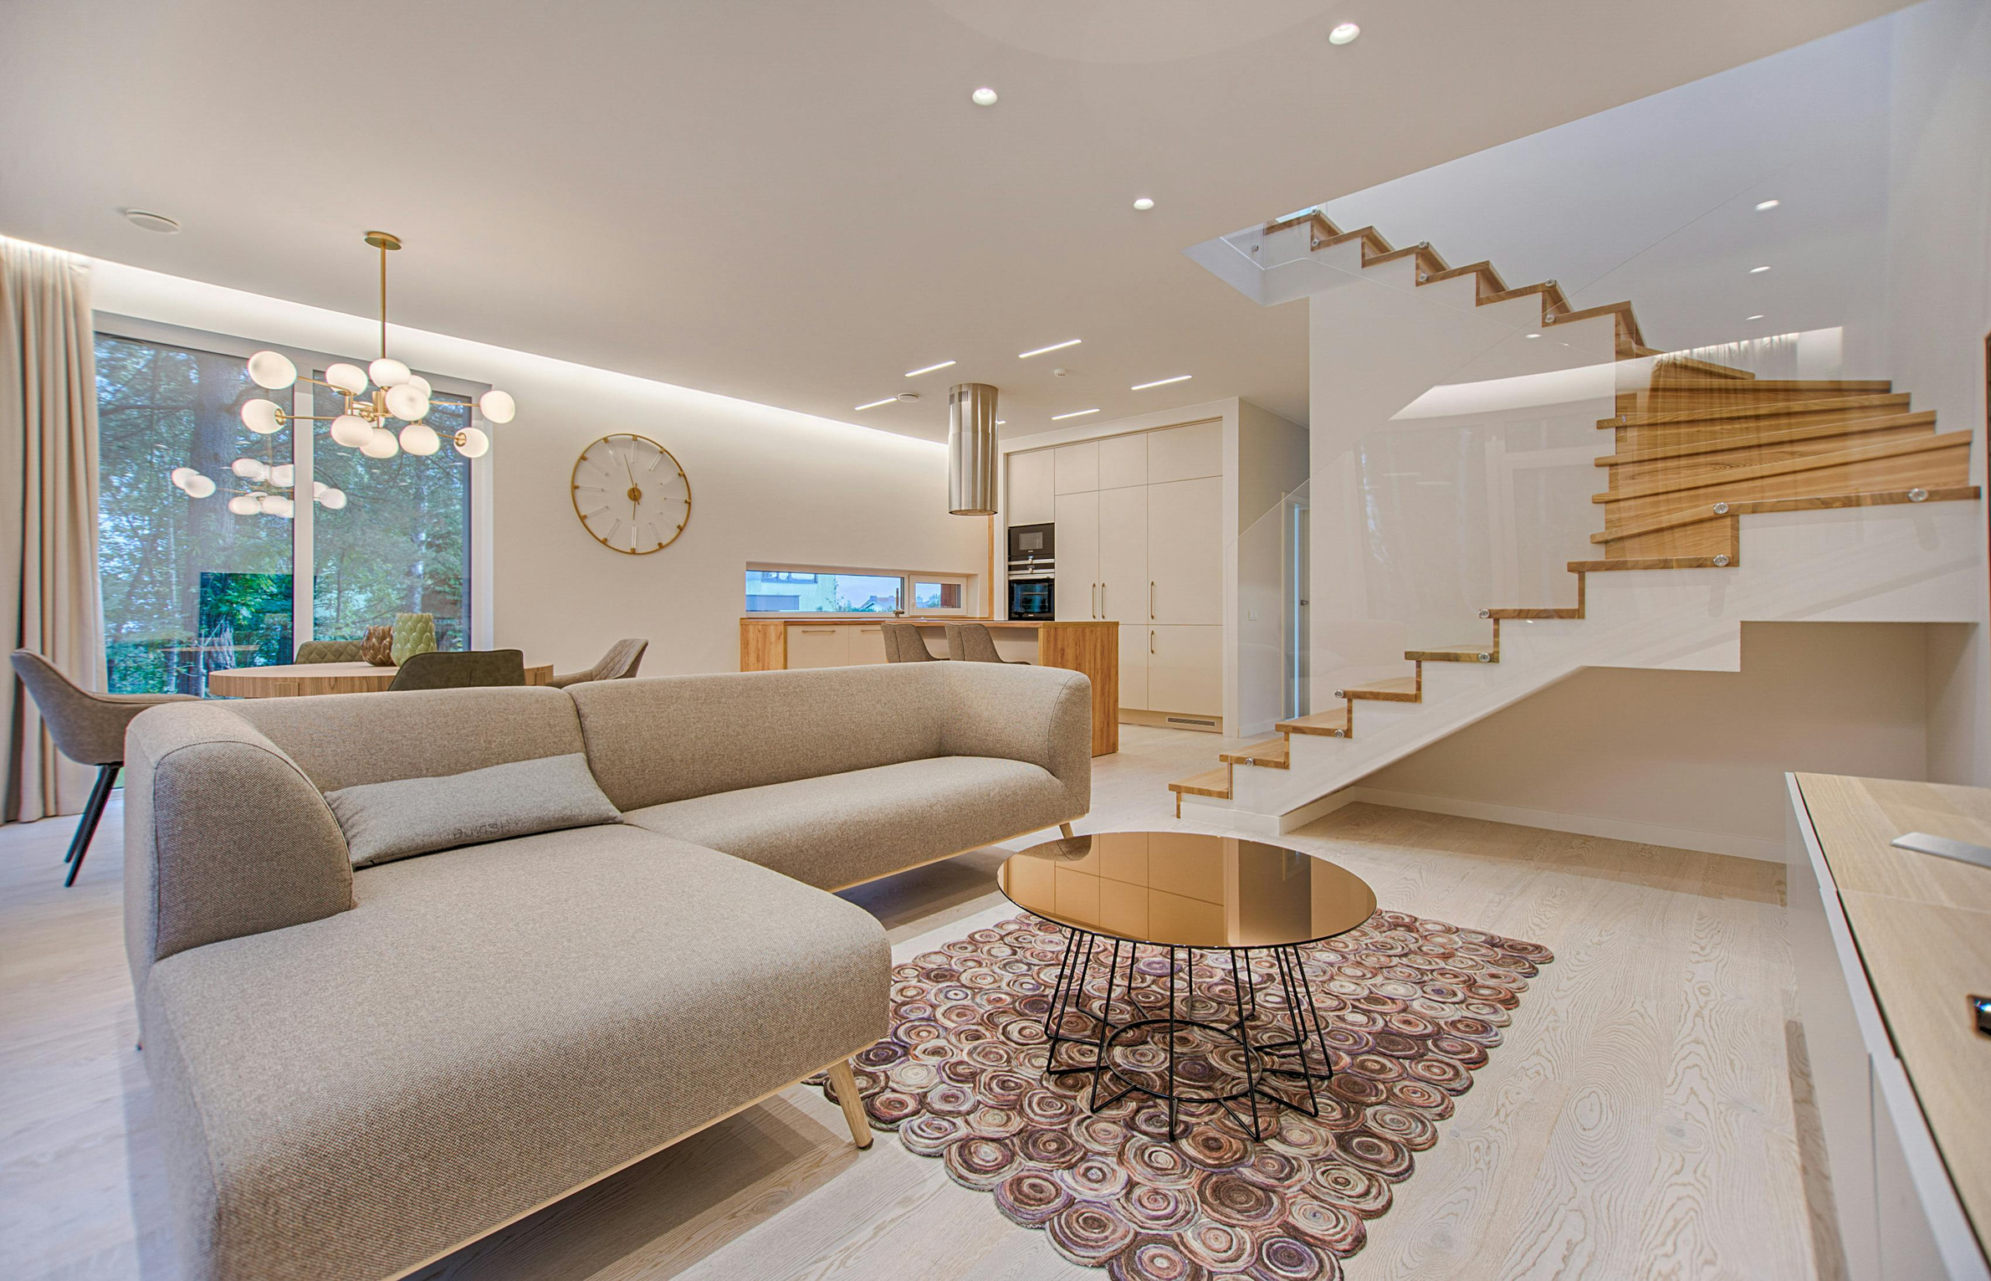
AMS GROUP
Home
About
Content
Others
THANK
YOU
-

